Slide 1

Department of Computer Applications AI Career Coach MAJOR PROJECT-I Odd Semester Session 2025-26
Team Members:
Prince Kumar - 202410116100149
Priyanshu Kansal - 202410116100155
Priyanshi - 202410116100153
Rahul - 20210116100157

Slide 2
Introduction
The AI Career Coach is a web app that helps people choose the right career path. It uses AI to give career advice, suggest skills to learn, and guide users toward their goals. The app has a simple design, login system, and stores user data safely in a database. It works like a personal coach to support career growth.
The app is built with modern web technologies, making it fast, secure, and easy to use on both computers and mobile devices. With an attractive interface and smooth experience, it ensures that users stay engaged while exploring their career options.
Notes:
Font Styles: Times New Roman + Font Size: 25

Slide 3
Requirements
HARDWARE REQUIREMENTS:
Processor: Intel i3 or higher
RAM: Minimum 4 GB (8 GB recommended)
Storage: At least 500 MB free (excluding PostgreSQL setup)
Internet connection (for API calls, AI features, and npm install)
SOFTWARE REQUIREMENTS: Node.js (v18 or later)
npm or yarn (comes with Node.js)
Database: PostgreSQL
VS Code (or any IDE of your choice)
Git (optional, for version control)
Notes:
Font Styles: Times New Roman + Font Size: 25

Slide 4
Tech Stack
🔹 Frontend
React Framework → server-side rendering, fast routing, SEO friendly.
Tailwind CSS / CSS Modules → responsive & modern UI styling.
🔹 Backend
Node.js API Routes → For backend logic .
Prisma ORM → Interaction with the Database (type-safe queries).
🔹 Database
PostgreSQL → relational database for storing users, skills, career suggestions, etc.
🔹 Authentication & Security
NextAuth.js (or custom auth) → Login / Signup system with Google & Email.
JWT / Sessions → secure user authentication.
Bcrypt → password hashing.
Notes:
Font Styles: Times New Roman + Font Size: 25

Slide 5

Individual Roles
Prince Kumar – Authentication Module
Priyanshu Kansal – AI Career Recommendation Module
Priyanshi – Frontend UI Module
Rahul – Database Module
Notes:
Font Styles: Times New Roman + Font Size: 25

Slide 6
Literature Review
1. Traditional Career Guidance Approaches
Old career counseling mostly uses tests, interviews, and expert advice. It is useful but not very personal and often gives the same advice to everyone.
2. AI and Recommender Systems in Career Coaching
AI tools study a person’s skills, interests, and job market trends to suggest better careers. Machine learning and NLP help give advice that fits each person. Examples are LinkedIn career insights and Coursera skill recommendations.
3. Ethical and User-Centric Considerations
AI career tools should be clear and fair in their suggestions. They must avoid bias and keep user data safe. Privacy and trust are very important for people to use these systems.

Slide 7
Objective of the Project
The main objective of this project is to develop an AI-powered Career Coaching system that helps individuals choose the right career path. The system aims to provide personalized guidance by analyzing a user’s skills, interests, and career goals. It also recommends relevant skills, courses, and learning resources, while ensuring fairness, transparency, and data privacy.
In addition, the project focuses on making career counseling more accessible, scalable, and cost-effective compared to traditional methods. By using machine learning, natural language processing, and recommender systems, the AI Career Coach can adapt to different users, stay updated with market trends, and guide learners towards better opportunities.

Slide 8
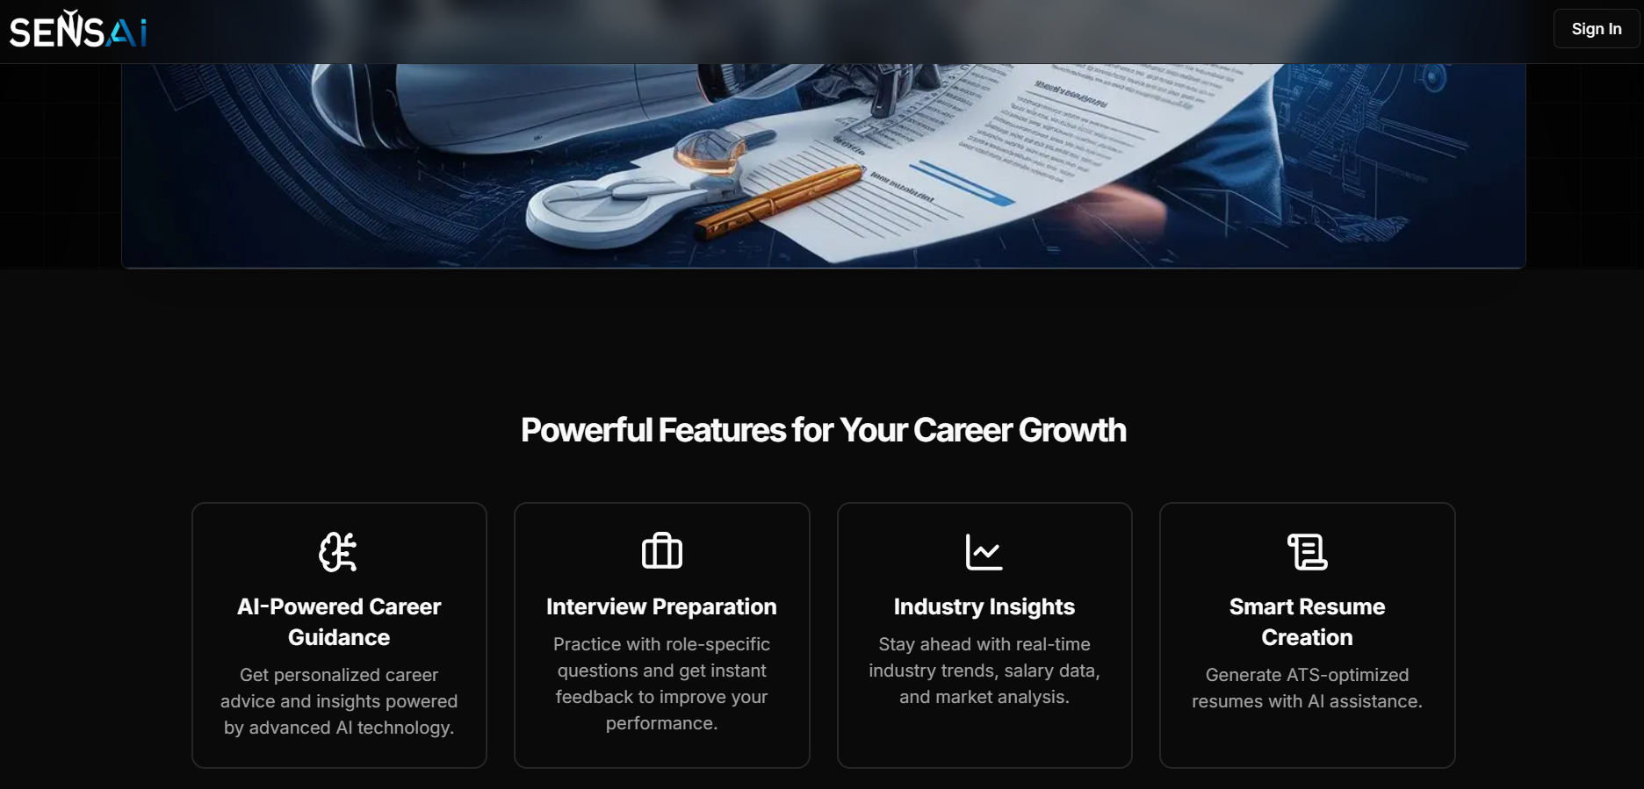
Home Page

Slide 9
Reports
Using AI, it provides personalized career suggestions, recommends skills and courses, and tracks progress through an easy-to-use dashboard.
Key Points:
Personalized career recommendations using AI/ML
Skill suggestions with learning roadmap (Beginner → Advanced)
User authentication via Email & Google OAuth
Editable profile with skills, education, and interests
Dashboard to track progress and save suggestions
PostgreSQL database for secure data storage
Frontend & backend deployed on vercel.

Slide 10
Conclusion
The AI Career Coach provides a personalized, data-driven, and scalable solution for career guidance. By combining AI recommendations, skill roadmaps, and interactive dashboards, it simplifies the career decision-making process and empowers users to take informed steps toward their professional goals.

Slide 11
Thank You

